Slide 1
Ruby on Rails for Beginners

Slide 2

Faculty
 | Mahima Agarwal Saran
 | Team Lead
 | ADOP Offshore Lead
 | DCSC, Mumbai IDC

Slide 3
Agenda
Creating a Demo site
Starting Rails Server on Local machine
Ruby on Rails Routes
Running the Demo app with Hello world Text
Ruby on Rails Active Records
Developing a User resource
Rake
Migrations
Migrating DB
A user tour

Slide 4
Creating a Demo Site
$ mkdir workspace
$ cd workspace
$ rails new demo_app
create
create README.md
create Rakefile
create config.ru
create .gitignore
create Gemfile
create app
create app/assets/config/manifest.js
create app/assets/javascripts/application.js
create app/controllers/application_controller.rb
create vendor/assets/javascripts
create vendor/assets/stylesheets
create vendor/assets/stylesheets/.keep
remove config/initializers/cors.rb
run bundle install
Fetching gem metadata from https://rubygems.org/..........
Fetching additional metadata from https://rubygems.org/..
Resolving dependencies...
Installing rake 11.1.2
Using concurrent-ruby 1.0.2
Your bundle is complete!

Slide 5
Running the Rails server on a local machine
Adding a hello action to the Application controller.
Go to Application Directory
Start the In-built WEBrick Web server (We can use any Web server with ROR)
Default environment is development
Default port is 3000
http://127.0.0.1:3000
$ cd ~/workspace/demo_app/
$ rails server Booting Puma Rails application starting on http://localhost:3000 => Run `rails server -h` for more startup options => Ctrl-C to shutdown server

Slide 6
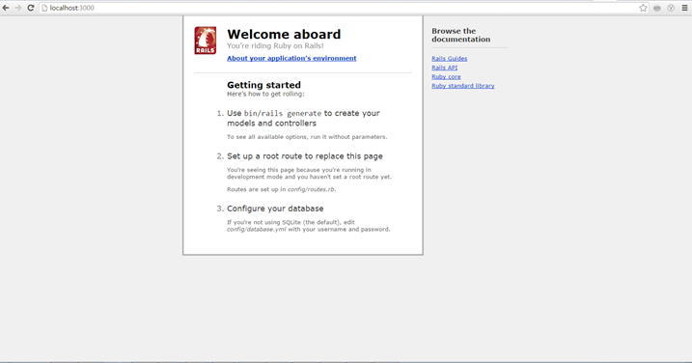
Running the Rails server on a local machine

Slide 7
Ruby on Rails Routes
Router is the doorman of the application
Rails handles routing via the config/routes.rb file
When an HTTP request arrives from the user's browser, it needs to know which controller action (method) should be run
Router looks at the HTTP verb (GET, POST, PUT, DELETE) and the URL that it being requested and matches it with the appropriate controller action to run
If it can't find a route that matches the request, your application will throw an error

Slide 8
Routes file
Rails.application.routes.draw do
resources :users
# generates:
# get "/users" -- index on your controller
# get "/users/:id" -- show on your controller
# get "/users/new" -- new method on your controller
# post "/users" -- create on your controller
# get "/users/:id/edit" -- edit method on your controller
# put "/users/:id" -- update on your controller
# patch "/users/:id" -- update on your controller
# delete "/users/:id" -- destroy on your controller
end
resources tells Rails to specify the below actions for a given controller
The second keyword, resource is used if we are interacting with a single resource

Slide 9
Demo App with Hello world Text
Adding a hello action to the Application controller.
Add a controller action to app/controllers/application_controller.rb to render the string “hello, world!” to replace the default Rails page
Add action to app/controllers/application_controller.rb
$ cd ~/workspace/demo_app/ app/controllers $ vi application_controller.rb class ApplicationController < ActionController::Base protect_from_forgery with: :exception def hello render html: "hello, world!" end end

Slide 10
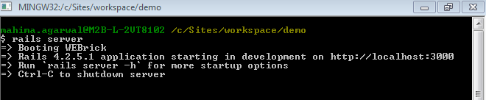
Running the Demo App
Adding a hello action to the Application controller.
Tell Rails server to o use that action instead of the default page
Edit the Rails router, which sits in front of the controller to determine where to send requests that come in from the browser
After saving the file run the server
The default routing file config/routes.rb
Rails.application.routes.draw do root 'application#hello' end

Slide 11
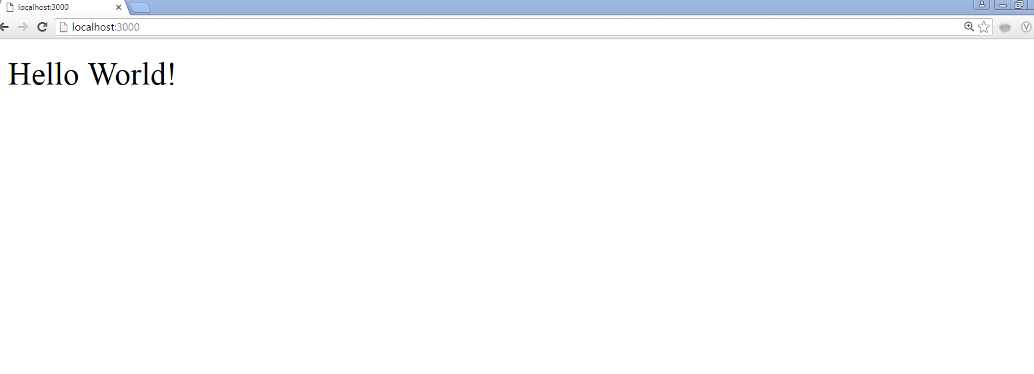
Running the Demo App

Slide 12
Ruby on Rails Active Records
Adding a hello action to the Application controller.
Active Record is the Object/Relational Mapping (ORM) layer supplied with Rails
Follows standard ORM model
tables map to classes,
rows map to objects and
columns map to object attributes.
Each Active Record object has CRUD (Create, Read, Update, and Delete) methods for database access
It follows below rules to translate a domain model into SQL
Each entity (such as user) gets a table in the database named after it, but in the plural (Users).
Each such entity-matching table has a field called id, which contains a unique integer for each record inserted into the table.

Slide 13
Developing a User resource
Generate a User Model ( Active Record File) having following fields
The label users corresponds to a table in a database, and the id, name, and email attributes are columns in that table
Using scaffolding we will generate a User Model :
$ rails generate scaffold User name:string email:string
Note that there is no need to include a parameter for id; it is created automatically by Rails for use as the primary key in the database
Users resource will be an object that can be created, read, updated, and deleted through the web
Users
Id | Integer
Name | String
Email | String

Slide 14
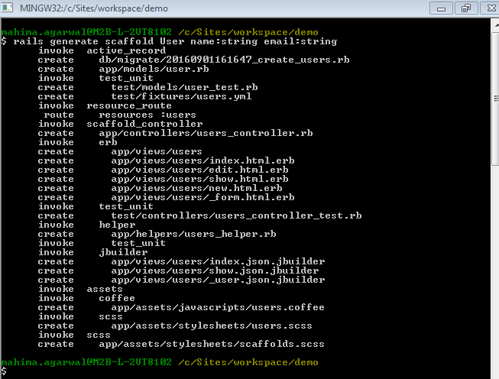
Developing a User Resource

Slide 15
Rake
Rake is a software task management and build automation tool similar to make in Unix
Written in Ruby Language
In Rails, it is most often used for administration level tasks that can be scripted
Rails comes with a set of predefined Rake tasks that allow you to perform database migrations, generate Rails scaffold files, etc.

Slide 16
Migrations
Rails Migration allows to make changes to database schema
They use a Ruby DSL(Domain Specific Language) so that users don't have to write SQL
Migration is a file that contains a specific set of instructions for the database
When we run a migration file for example to create a Table called users, Rails will be able to make the changes to the database and automatically create the table for us
As the application evolves, migration files act as a versioned history of how the database has changed

Slide 17
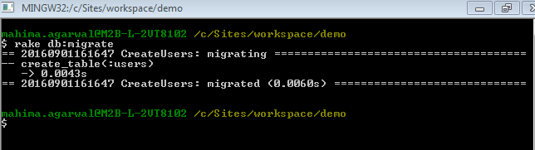
Migrating DB
To update the database with a data model we generated we need to run the db migrate command
rake db:migrate

Slide 18
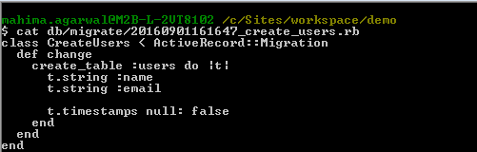
Migrating DB
DB migration file for User table

Slide 19
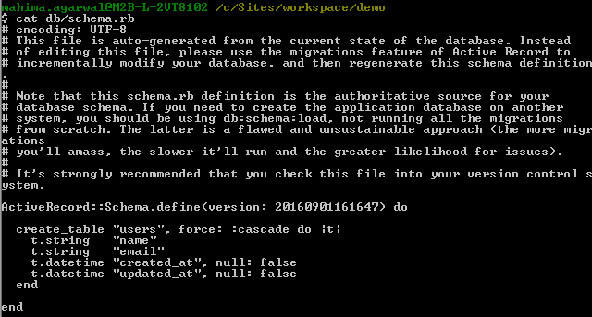
Migrating DB
Db schema

Slide 20
A user tour
Run the local web server and check the application

Slide 21
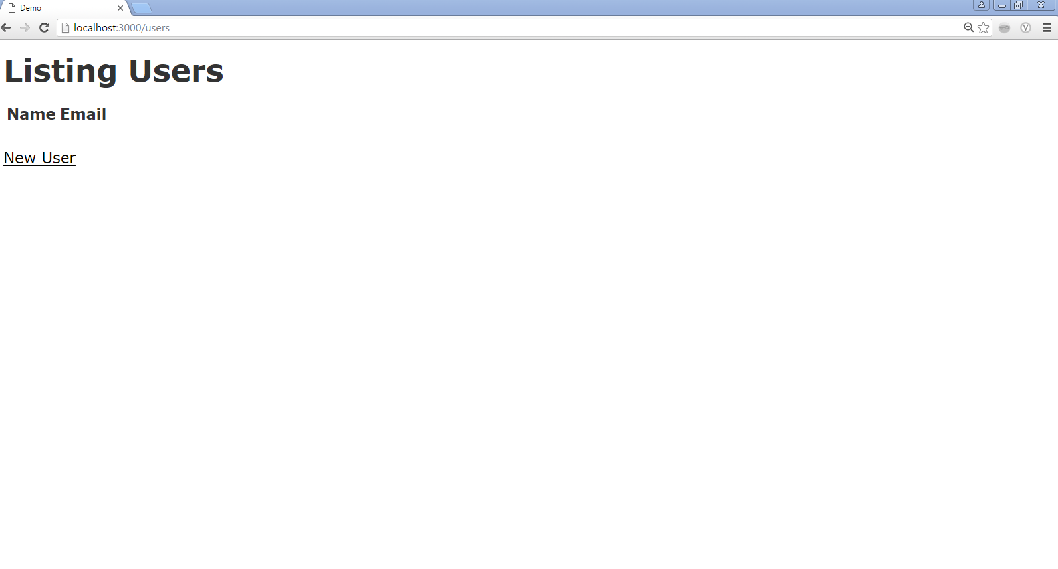
A user tour
http://localhost:3000/users

Slide 22
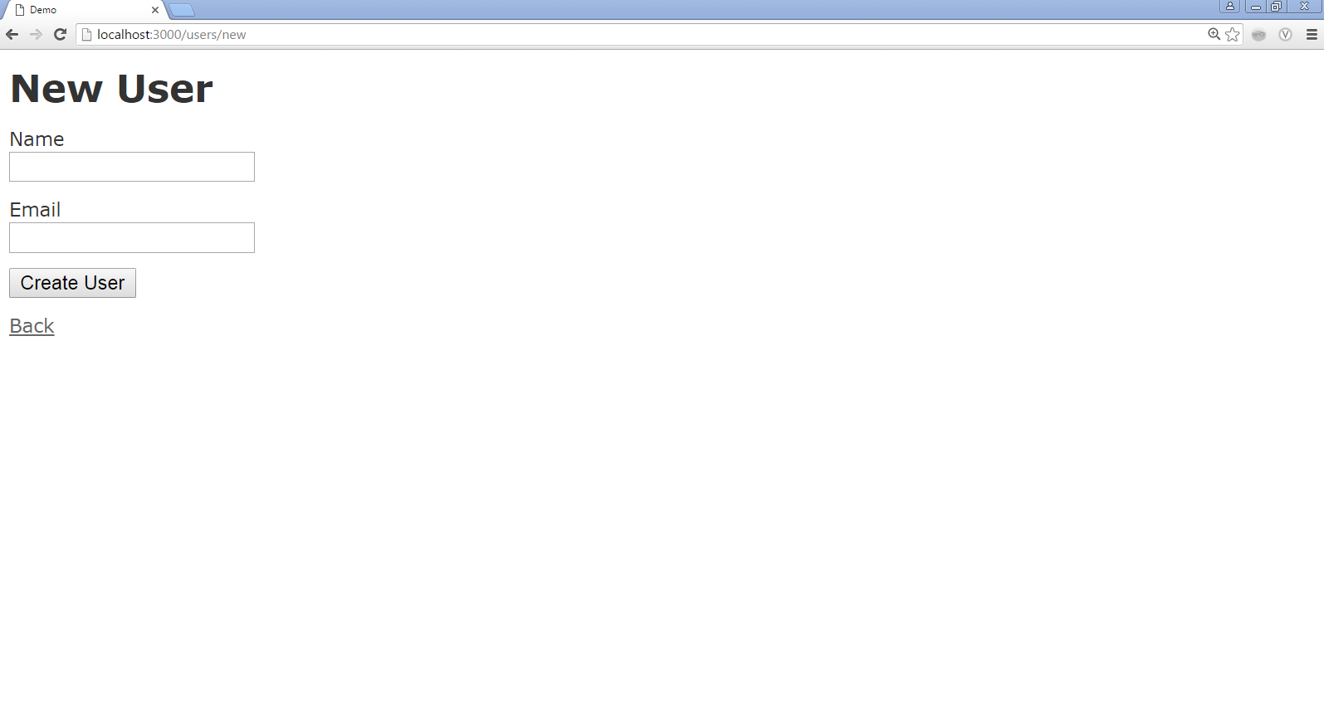
A user tour
http://localhost:3000/users/new

Slide 23
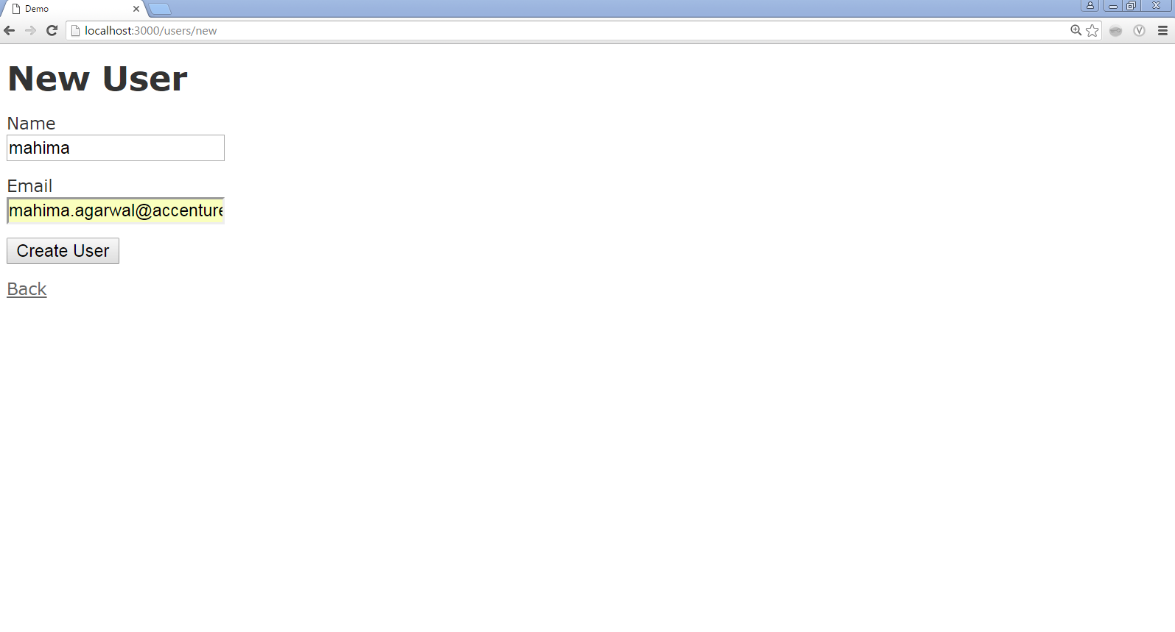
A user tour
http://localhost:3000/users/new
Click

Slide 24
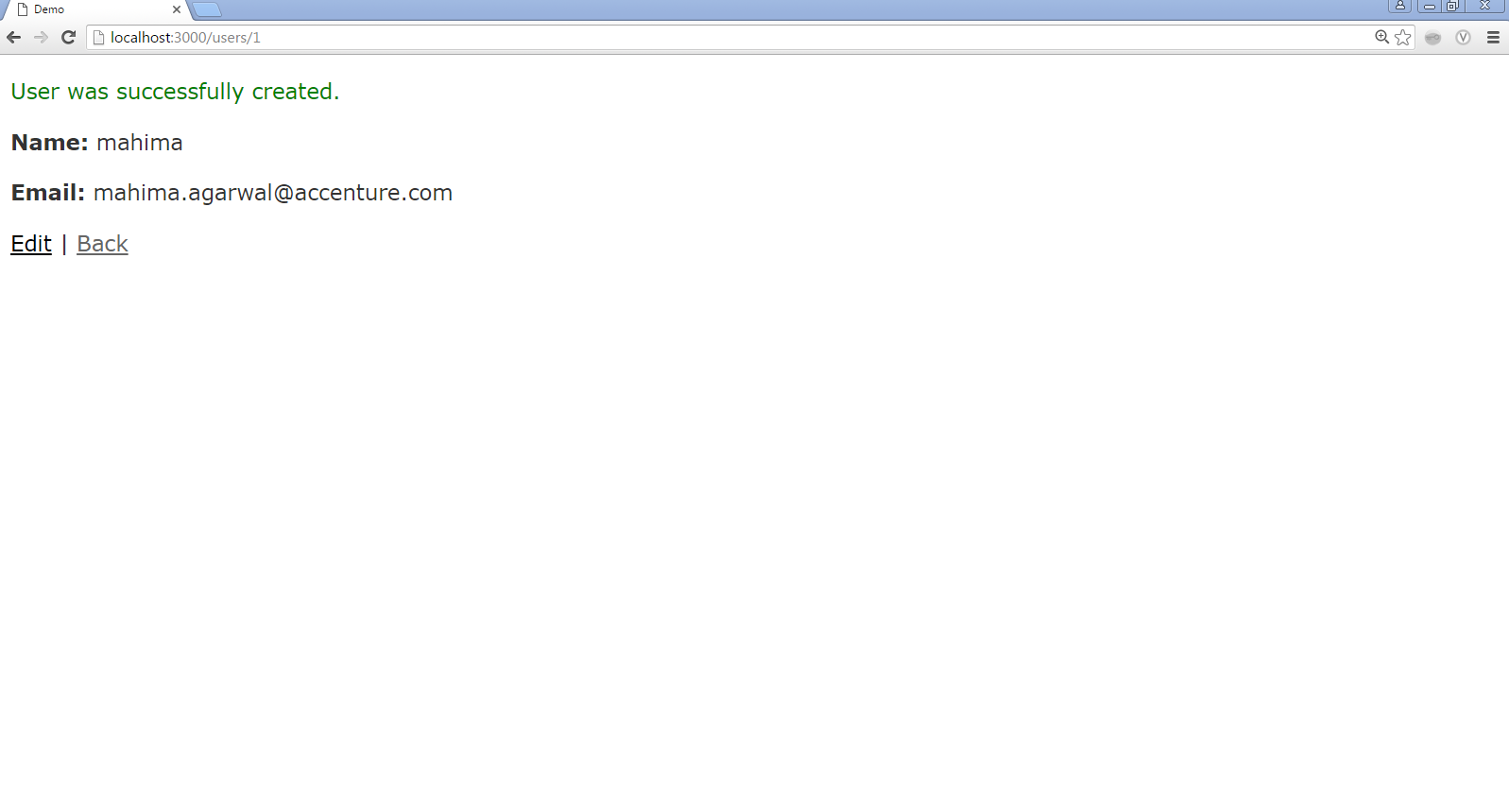
A user tour
http://localhost:3000/users/1
Click

Slide 25
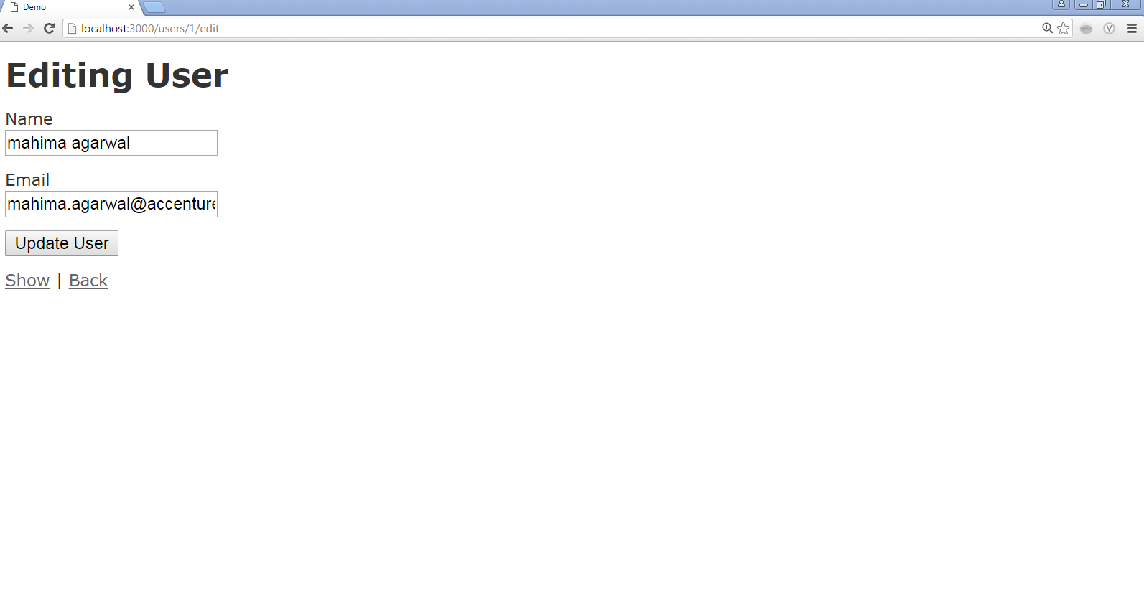
A user tour
http://localhost:3000/users/1/edit

Slide 26
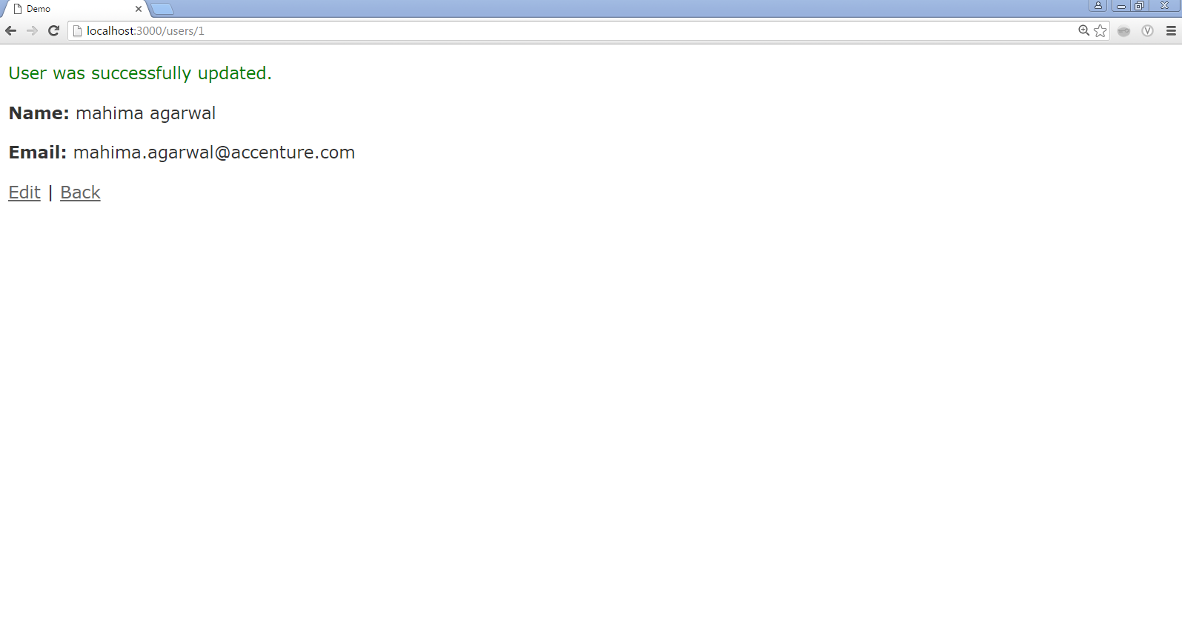
A user tour
http://localhost:3000/users/1

Slide 27
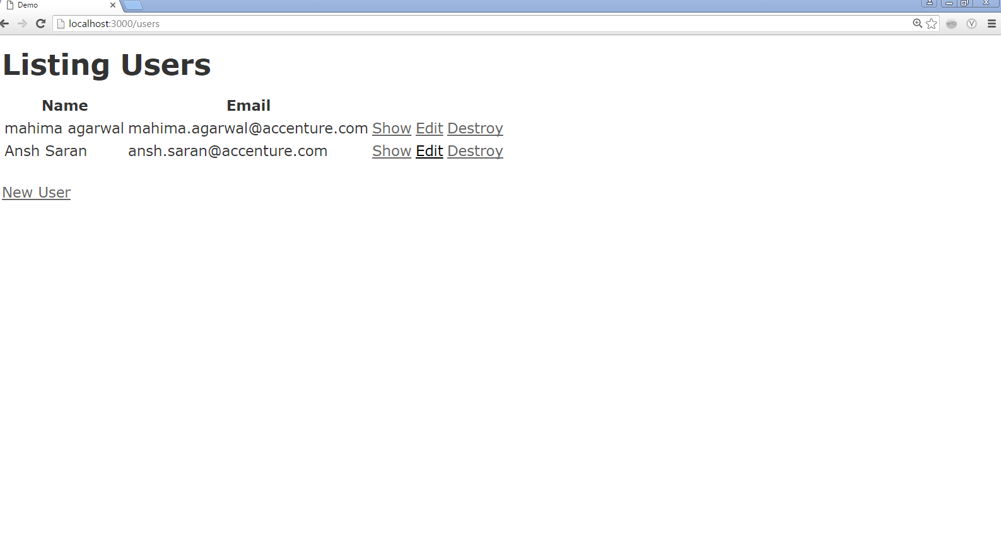
A user tour
http://localhost:3000/users/1

Slide 28
Rails Console
The console command allows to interact with Rails application (models, controllers, DB) directly from the command line
Its an irb session with rails application
Using -e or --environment option we can load cosole in all 3 different rails environment : test, development and production
For E.g. : rails console -e test
The test option puts everything done in that console session in a database transaction. The transaction is then rolled back when you exit the console
By default is environment is not specified, console is loaded in development environment

Slide 29
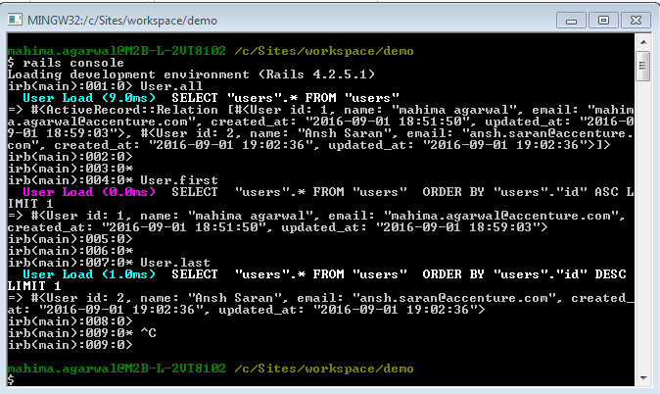
Rails Console

Slide 30
References
https://www.railstutorial.org/book/beginning
https://rubyonrails.org/
http://www.tutorialspoint.com/ruby-on-rails/

Slide 31
Thanks for attending!

